Slide 1

LOGISTIC REGRESSION ANALYSIS
NUTHANMANIDEEP

Slide 2

ABSTRACTION
The World Happiness Report 2015 dataset contains data on the happiness levels of people in 159 countries around the world. It includes information on a variety of factors that are thought to contribute to happiness, such as economic factors (GDP per capita), social factors (family, health, and freedom), and trust in government. The data also includes a happiness score and a happiness rank for each country. The happiness score and happiness rank are based on a poll in which people were asked to rate their overall happiness on a scale of 0 to 10. The economy, family, health, freedom, trust, and generosity columns contain various measures of those factors. Overall, the World Happiness Report 2015 dataset provides valuable insights into the factors that contribute to happiness and well-being at the national level, and can be used by researchers, policymakers, and others to better understand and promote happiness around the world.

Slide 3
DATA
.
The dataset can be found on Kaggle and it contains data on happiness levels of people in 159 countries around the world. The data is collected in the year 2015 and it includes information on a variety of factors that are thought to contribute to happiness, such as:
Column Name | Description
Country or Region | Name of the country
Happiness Score | A composite score of overall well-being
Economy (GDP per Capita) | Measure of the economic production of a country
Family | Measure of social support
Health (Life Expectancy) | Measure of the health of citizens
Freedom | Measure of freedom to make life choices
Generosity | Measure of generosity of citizens
Trust (Government Corruption) | Measure of trust in government

Slide 4
FULL LOGISTIC REGRESSION
A new variable Happiness_Cat is created for Logistic regression analysis where it contains 1 which means greater than mean Happiness or 0 which means less than mean Happiness.
The World Happiness Report 2015 dataset was divided into 60% training and 40% validation. The first set, the training set, would be used to fit the linear regression model and would contain 60% of the total data. The second set, the validation set, would be used to evaluate the performance of the model and would contain 40% of the total data.
A full Logistic Regression model is fitted by using all predictors. The coefficients of the full model are given in the table.
Variable | Estimate | P-value
(Intercept) | -19.3208119 | 0.0009845987
Economy (GDP per Capita) | 7.6631705 | 0.0337889054
Family | 6.4534031 | 0.0807727018
Health (Life Expectancy) | 5.9366848 | 0.1557630723
Freedom | 3.1143209 | 0.4418690026
Trust (Government Corruption) | 2.0524514 | 0.7336194356
Generosity | 0.6044032 | 0.8784020918

Slide 5
CONFUSION MATRIX OF FULL LOGISTIC REGRESSION
The confusion matrix of full model training data is given below:
 | Predicted Negative (0) | Predicted Positive (1)
Actual Negative (0) | 47 | 6
Actual Positive (1) | 2 | 39
The model's accuracy is 87.5%, with a specificity of 88.6% and a sensitivity of 86.4%.
The confusion matrix of full model validation data is given below:
 | Predicted Negative (0) | Predicted Positive (1)
Actual Negative (0) | 30 | 7
Actual Positive (1) | 5 | 22
The model's accuracy is 81%, with a specificity of 81% and a sensitivity of 81%.

Slide 6
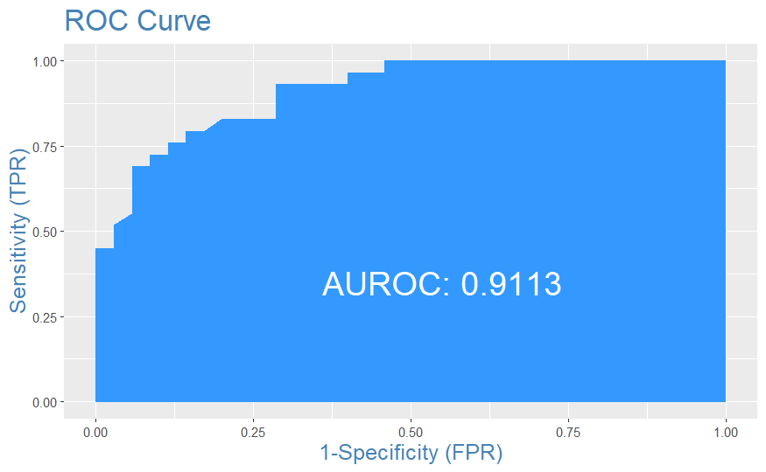
FULL LOGISTIC REGRESSION MODEL
One observation from the plot is that the model has a high AUC-ROC value of 0.9113. This suggests that the model has a low rate of false positives and false negatives, resulting in a high accuracy in classifying the data into the correct categories. This implies that the model has a good discriminatory power between the two classes.

Slide 7
MODEL-1
A logistic regression model is fitted by using Economy, Family, Health, Freedom and Trust (Government Corruption). The coefficients of the model-1 are given in the table. From the table the Economy and Family are statically significant because the p-value is less than 0.05.
Variable | Estimate | P-value
(Intercept) | -19.142768 | 0.0007052961
Economy (GDP per Capita) | 7.477746 | 0.0253183052
Family | 6.566475 | 0.0710079997
Health (Life Expectancy) | 5.910844 | 0.1481226606
Freedom | 3.238972 | 0.4162510765
Trust (Government Corruption) | 1.735307 | 0.7592808345

Slide 8
CONFUSION MATRIX OF MODEL 1
The confusion matrix of model-1 training data is given below:
 | Predicted Negative (0) | Predicted Positive (1)
Actual Negative (0) | 47 | 6
Actual Positive (1) | 2 | 39
The model's accuracy is 87.5%, with a specificity of 88.6% and a sensitivity of 86.4%.
The confusion matrix of model-1 validation data is given below:
 | Predicted Negative (0) | Predicted Positive (1)
Actual Negative (0) | 30 | 7
Actual Positive (1) | 5 | 22
The model's accuracy is 81%, with a specificity of 81% and a sensitivity of 81%.

Slide 9

MODEL-1
One observation from the plot is that the model has a high AUC-ROC value of 0.9113. This suggests that the model has a low rate of false positives and false negatives, resulting in a high accuracy in classifying the data into the correct categories.

Slide 10
MODEL-2
A logistic regression model is fitted by using Economy, Family, and Health, Freedom.The coefficients of the model-2 are given in the table. From the table the Economy, Family, Health and Freedom are statically significant because the p-value is less than 0.05.
Variable | Estimate | P-value
(Intercept) | -18.996324 | 0.0006336899
Economy (GDP per Capita) | 7.541697 | 0.0218207325
Family | 6.653917 | 0.0687933061
Health (Life Expectancy) | 5.628479 | 0.1383836074
Freedom | 3.438013 | 0.3835160093

Slide 11
CONFUSION MATRIX OF MODEL 2
The confusion matrix of model-2 training data is given below:
 | Predicted Negative (0) | Predicted Positive (1)
Actual Negative (0) | 47 | 7
Actual Positive (1) | 2 | 38
The model's accuracy is 89%, with a specificity of 87% and a sensitivity of 95%.
The confusion matrix of model-2 validation data is given below:
 | Predicted Negative (0) | Predicted Positive (1)
Actual Negative (0) | 30 | 7
Actual Positive (1) | 5 | 22
The model's accuracy is 81%, with a specificity of 81% and a sensitivity of 81%.

Slide 12
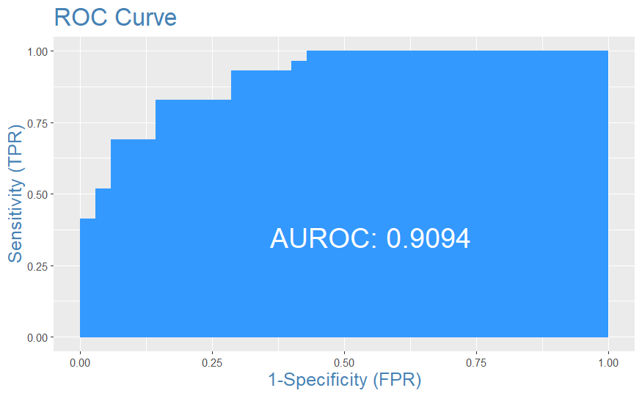
MODEL-2
One observation from the plot is that the model has a high AUC-ROC value of 0.9094.

Slide 13
MODEL-3
A logistic regression model is fitted by using Economy, Family and Freedom.The coefficients of the model-3 are given in the table. From the table the Economy is statically significant because it is less than 0.05.
Variable | Estimate | P-value
(Intercept) | -15.301073 | 0.0001510331
Economy (GDP per Capita) | 9.009255 | 0.0012238118
Family | 5.292964 | 0.1020203284
Freedom | 3.926902 | 0.2942834238

Slide 14
CONFUSION MATRIX OF MODEL 3
The confusion matrix of model-3 training data is given below:
 | Predicted Negative (0) | Predicted Positive (1)
Actual Negative (0) | 46 | 7
Actual Positive (1) | 3 | 38
The model's accuracy is 89%, with a specificity of 87% and a sensitivity of 93%.
The confusion matrix of model-3 validation data is given below:
 | Predicted Negative (0) | Predicted Positive (1)
Actual Negative (0) | 30 | 6
Actual Positive (1) | 5 | 23
The model's accuracy is 78%, with a specificity of 83% and a sensitivity of 82%.

Slide 15
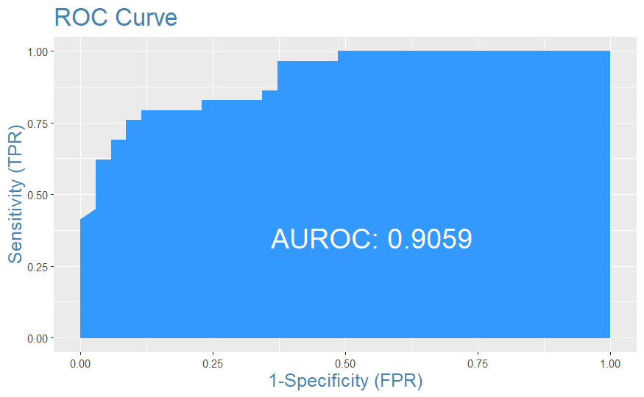
MODEL-3
One observation from the plot is that the model has a high AUC-ROC value of 0.9059.

Slide 16
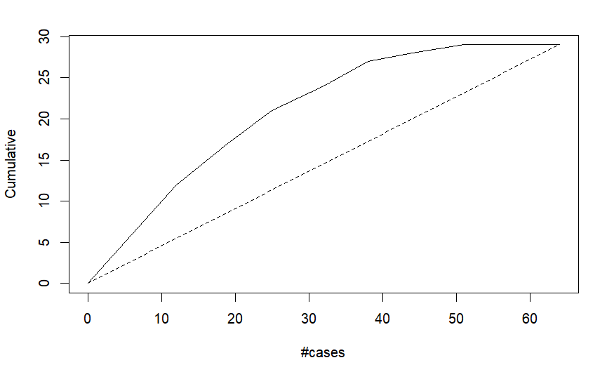
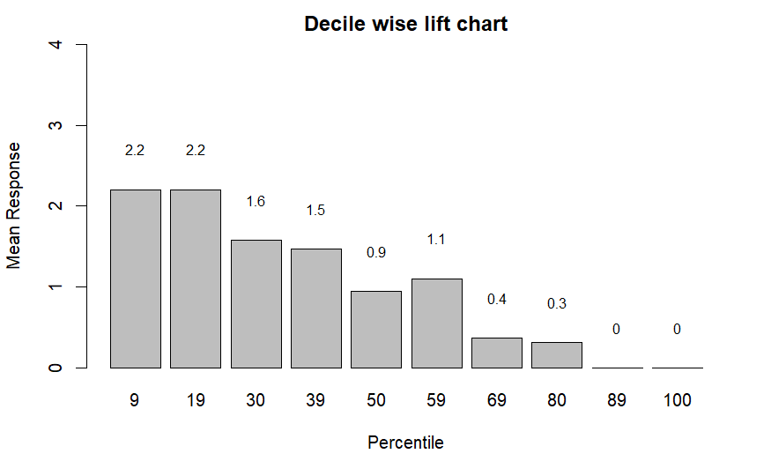
Model-1 is the best model among all the models considered, as it has the highest accuracy for training and validation data as well as the highest AUC-ROC value of 0.9113. Additionally, the model uses a combination of factors including economy, family, health, freedom and trust (government corruption) as input variables, which suggests that these factors may be important predictors for the outcome of interest. Decile wise chart and gains plot of the best model are plotted below.

Slide 17
CONCLUSION
Based on the results presented in this report, it appears that model-1 is the best model among all the models considered. This model has the highest accuracy for both training and validation data, as well as the highest AUC-ROC value of 0.9113. Additionally, the model uses a combination of factors such as Economy and Family, which are statically significant with p-value less than 0.05. The model's accuracy for validation data is 81%, with a specificity of 81% and a sensitivity of 81%. The model's accuracy for training data is 87.5%, with a specificity of 88.6% and a sensitivity of 86.4%. Overall, the model demonstrates good performance in predicting the outcome of interest, suggesting that the factors included in the model are important predictors.

Slide 18

THANK YOU!

